Slide 1
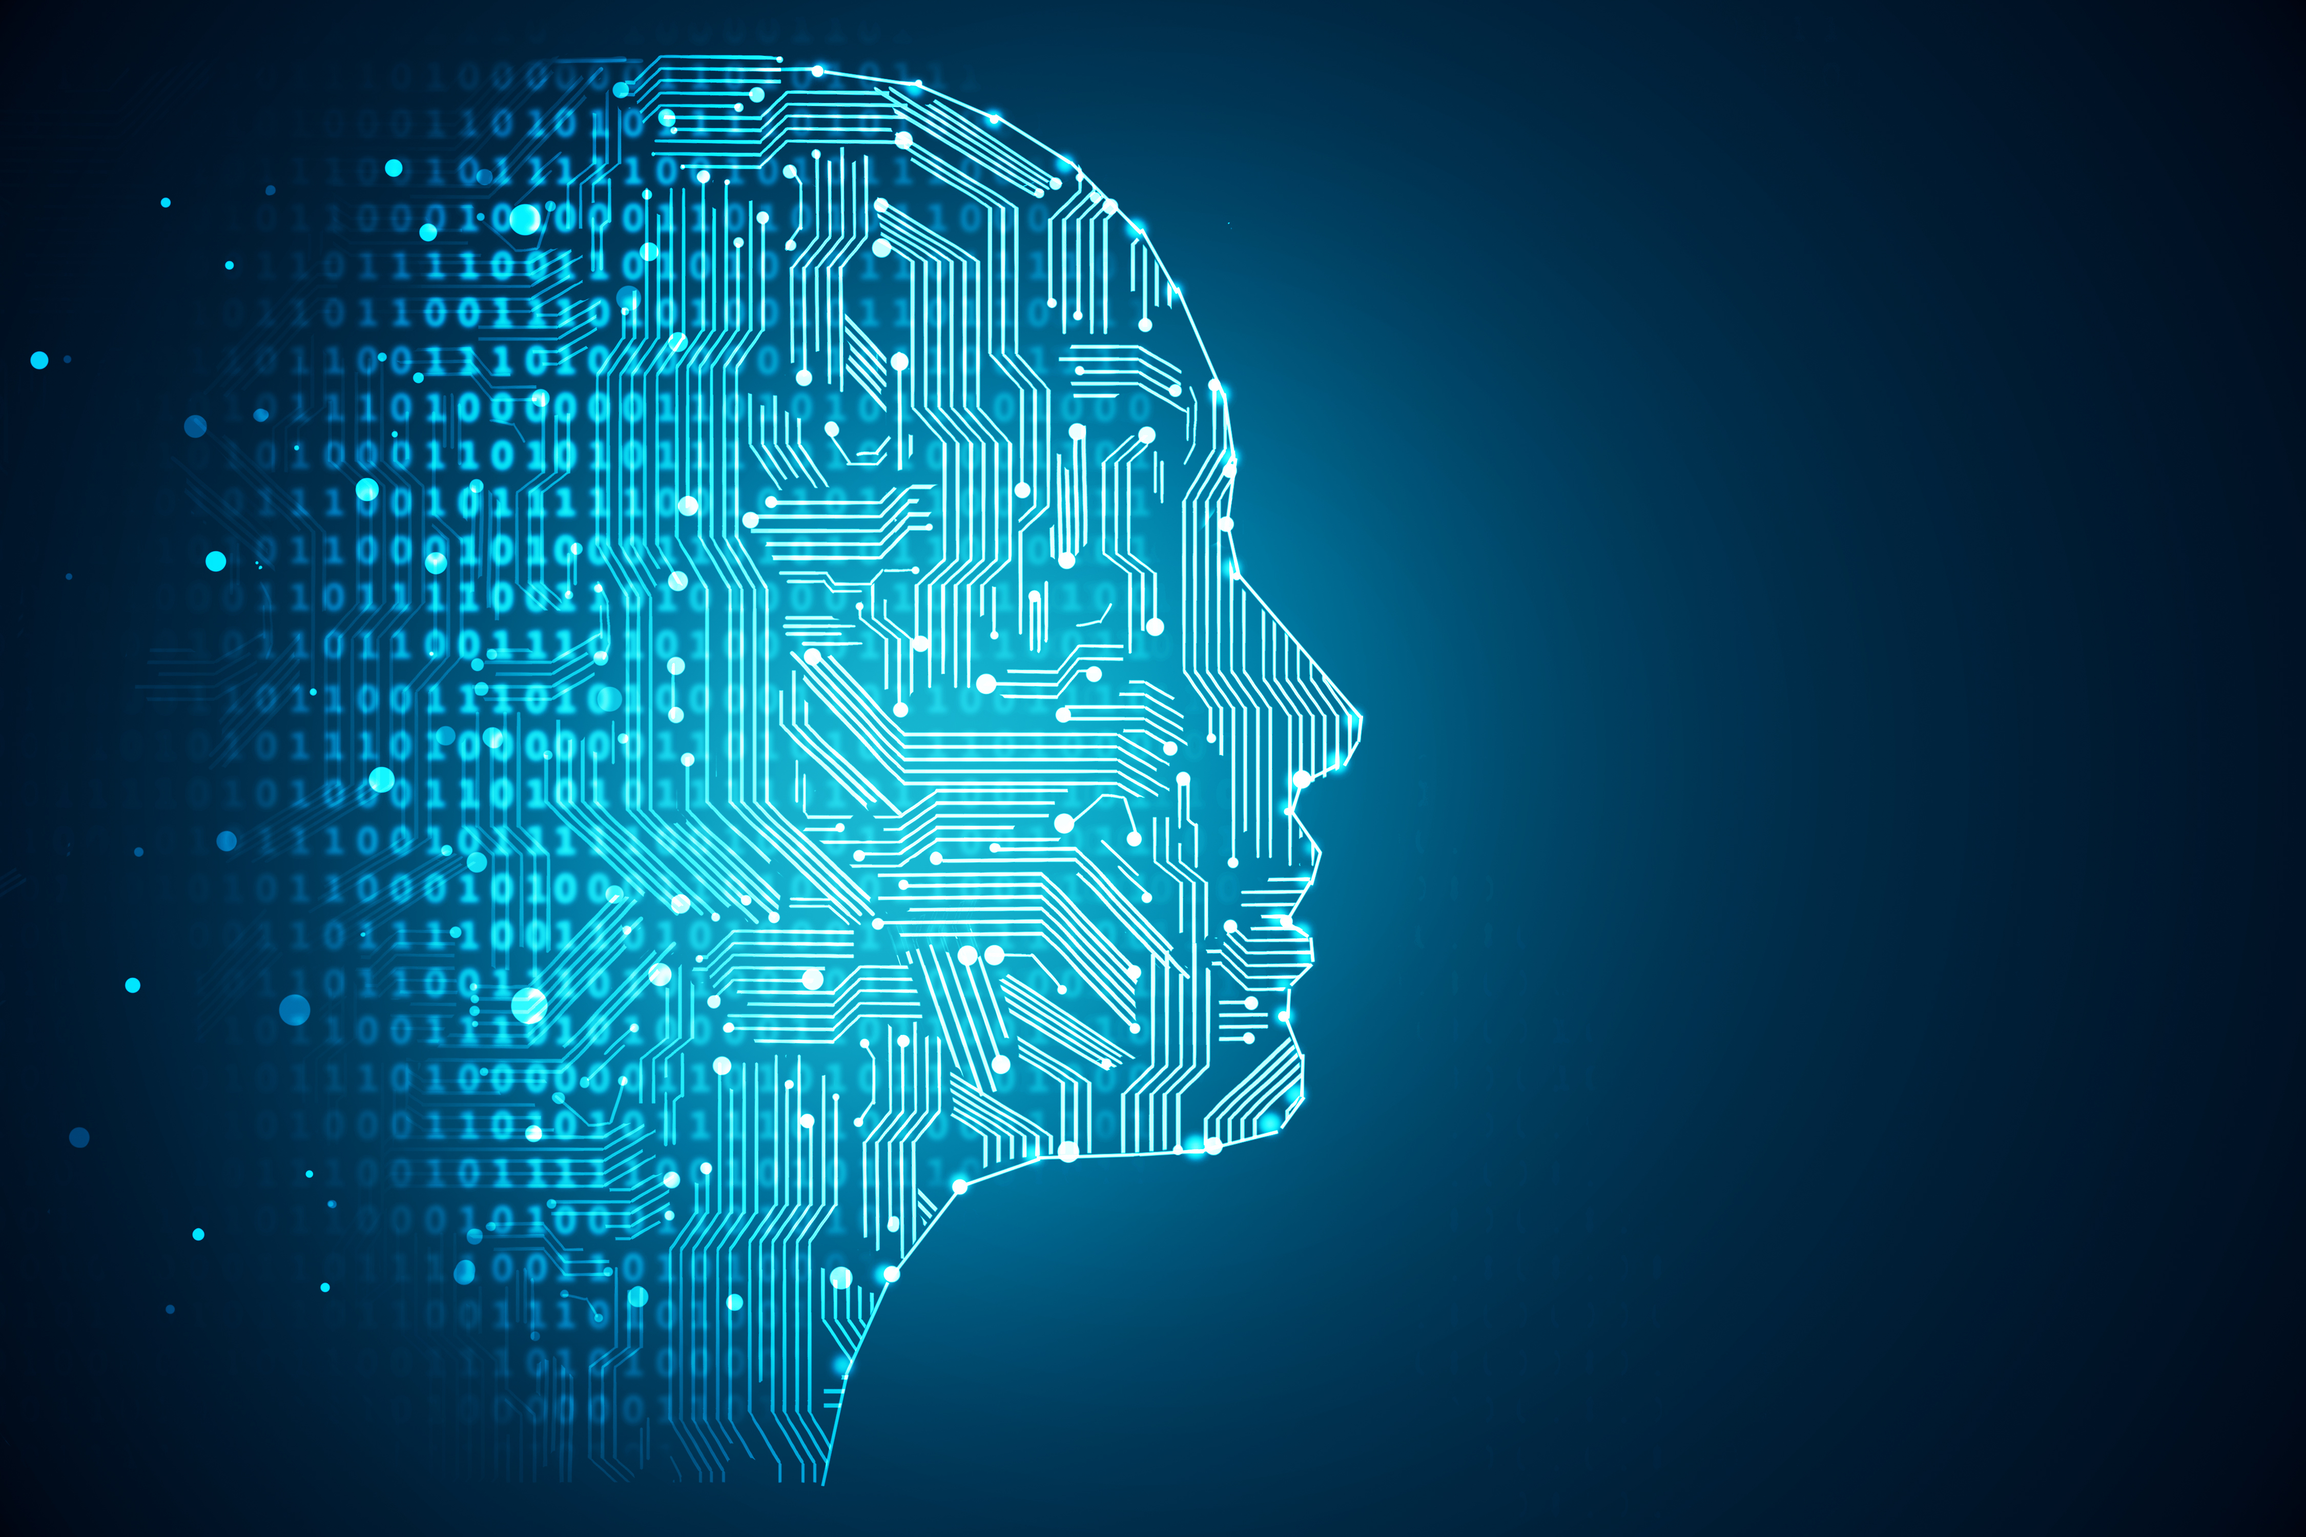
CHATDOT.
COUNSELLING CHATBOT FOR EDUCATION , ENTERTAINMENT AND SPORTS
TEAM NAME – THE_DOTS.

Slide 2
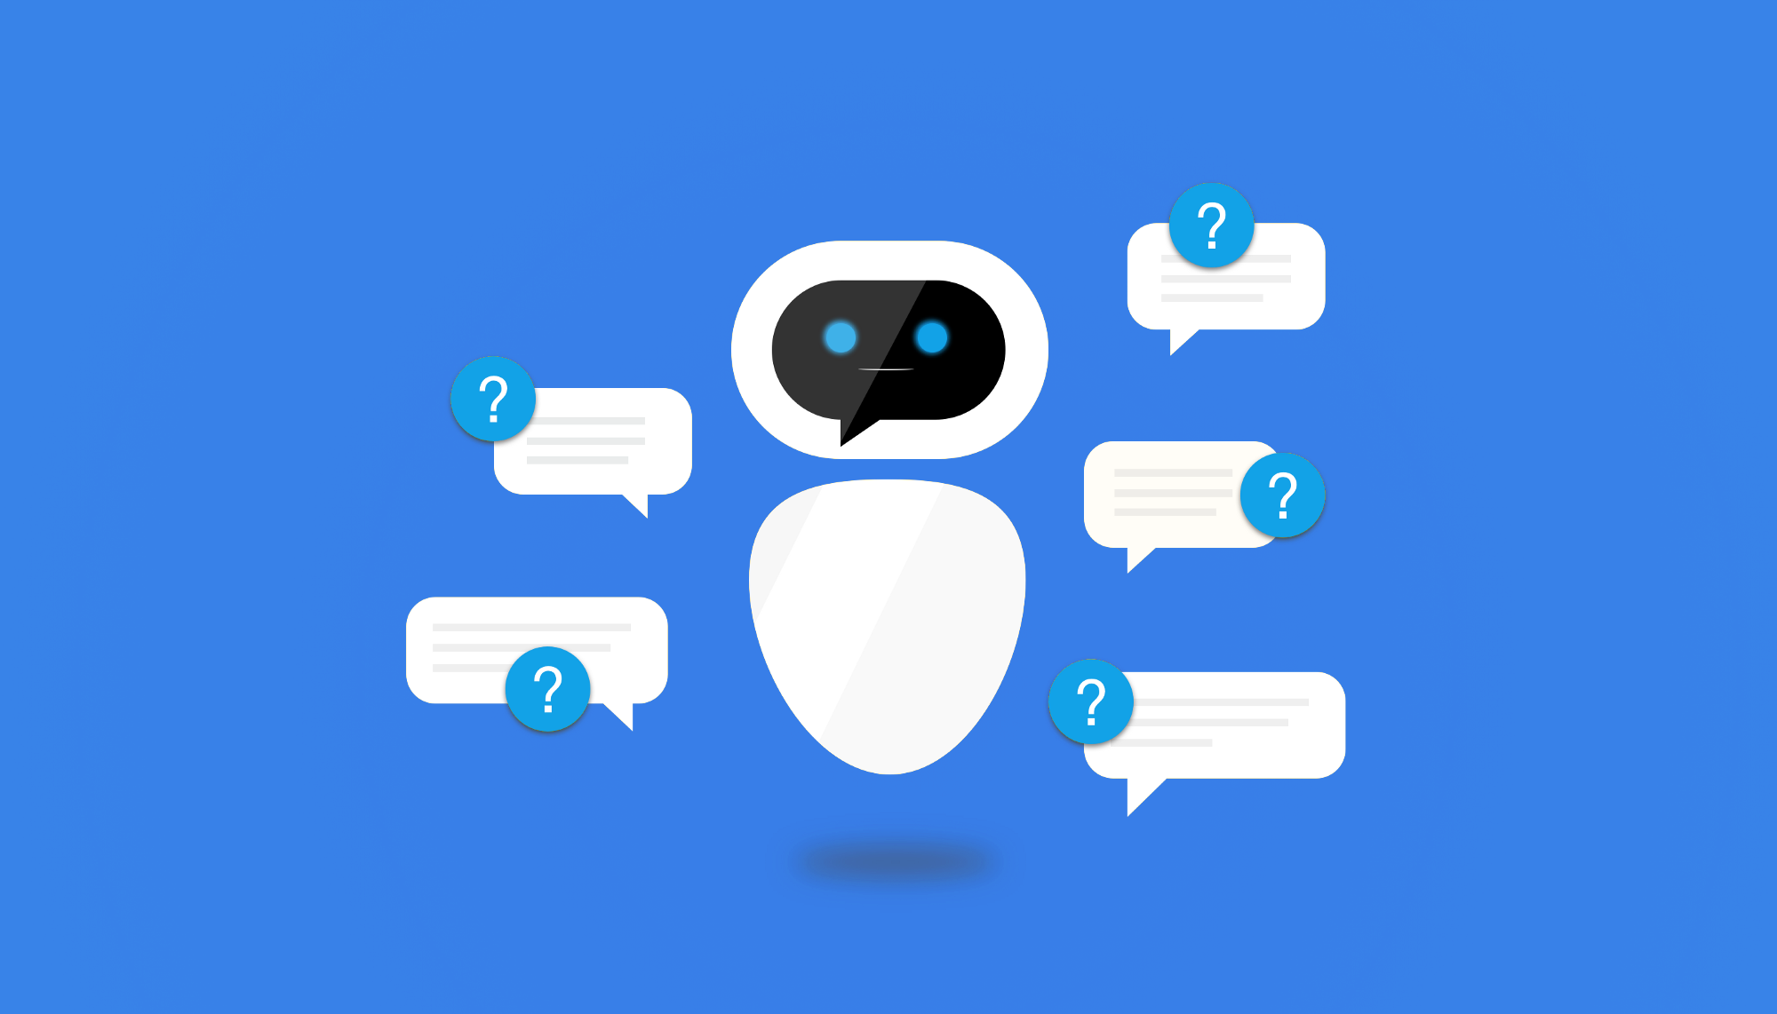
A. PROBLEM STATEMENT:
Career counselling Chatbot for Education, Entertainment and Sports
B. ABSTRACT:
Chatbot for science students who intend on pursuing engineering in future.
Our Bot has the ability to mimic the User Voice and passed the Turing Test
It can also make Phone calls and message Like the ChatDot Owner With his permission
ChatDot mainly focused on Career Queries and Suggestion, in Addition to that it can Handle Entertainment and Sports Related Questions
Memory Networking And Connectivity Our the Special Features Of the ChatDot
This PDF will describe the solution of an intelligent Career Counselling Bot.
Career Counselling Bot is built using artificial intelligence algorithms that are used for analysing user’s queries and understand user’s message.
Keywords: Chatbots , NLP , Knowledge base , Artificial intelligence .

Slide 3
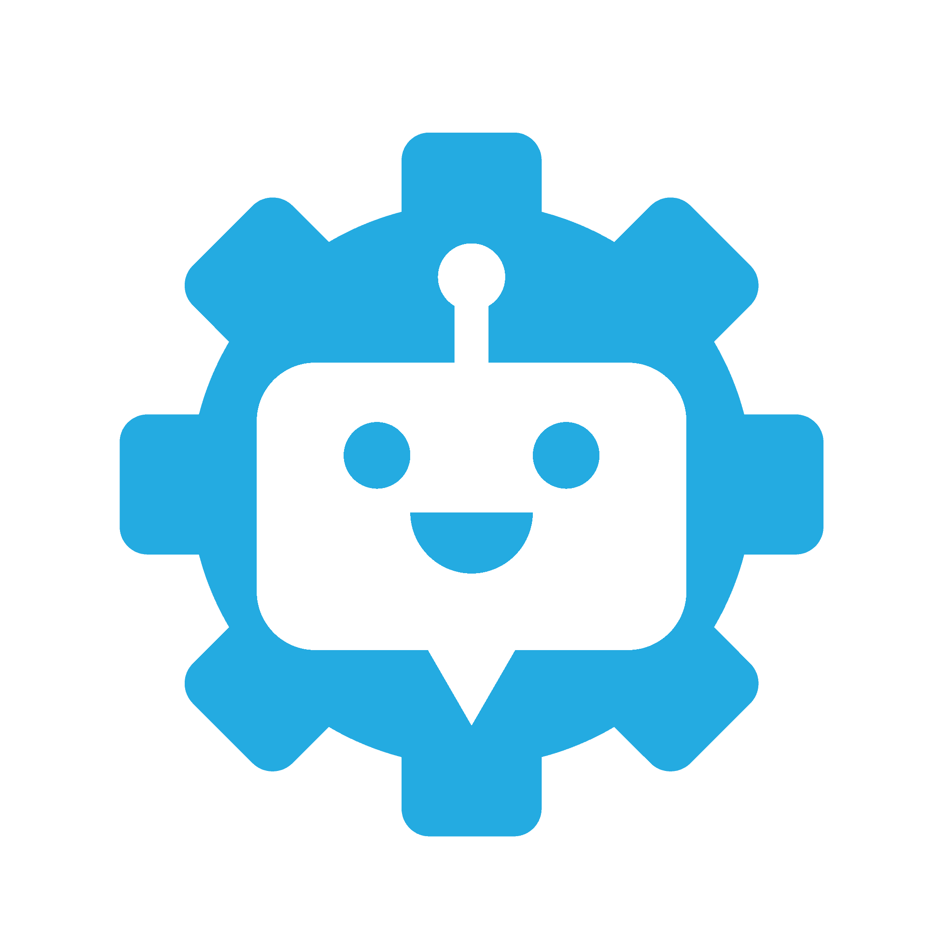
C. TECHNOLOGY STACK:
TOOL | MACHINE LEARNING LIBRARY
CONDA(PYTHON) | GOOGLE’S TENSORFLOW
NEURAL NETWORK LIBRARY | BOTFLOW CREATION
KERAS | Converse.ai, ManyChat , Octane.ai
API | DATASET
GOOGLE’S CLOUD NATURAL LANGUAGE API | 1. Dialogue Dataset by Cornell University 2. Dot Dataset(info regarding Career Choice,sports and entertainment)
NOTE: THE COMPLETE MODULE AND LIBRARY IS MENTIONED IN PAGE NO:6

Slide 4
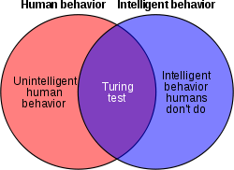
PROPOSED SOLUTION
The aim of counselling bot will help students clear their doubts related to engineering degree/branches and ALL Competitive Exams
Some Knowledge has been embedded into the machine so that it identifies the sentences and making a decision itself as response to answer a question.
The response principle is to extract the tokens from the sentence process on that find the goal of sentence by matching the input sentence from user.
This system can be used by any user who is confused about choosing the future career or anyone who wants to know what career they should choose that would be beneficial for them in future. The bot will help the users who have passed
SSC and HSC to select their field of interest or a field that would be best for them in order to build up their future.
(NOTE: Our Chatbot can mimic human responses and Our model passes TURING TEST)

Slide 5
D.1 ADVANTAGES
This system will help the user by answering the career, entertainment and Sports related queries.
User does not have to follow standard format while asking any queries.
The built in artificial intelligence system will carry out all the processing to give suitable answers to the user.
System uses a graphical representation of a person speaking while giving answers as a real person would do.
In future reference we are trying to implement our system that will cover all the career,sports and entertainment fields.
D.2 INNOVATION AND DEVELOPMENTS
ChatDot has a special feature called CONNECTIVITY which has the ability to connect the right people to right person
Connectivity allow the user to connect to rightful person which will be a Life Changer for Our Customer
Memory Networking is a feature which Combines all The Dataset Of the User Response and Internet Information and Produces the Humanization Output which helps to Clear Turing Test
ChatDot Clear the Turing Test even, Alexa and Siri failed.
ChatDot can give suggestion like best colleges for User and etc can be added accordingly to the user's needs and Rank Prediction.
ChatDot also Mimic the User Voice and Can act as the User, which Can be Used for messaging, Phone calls Based on the User Permission

Slide 6
E. METHODOLOGY AND IMPLEMENTATION
E.1 ALGORITHM
First system will take input from user either in text or speech or voice format.
The Voice format will be converted to the text format and the text format will be considered as it is.
Process the received queries using the response generation module which makes use of a data repository.
Search in Database appropriate answer.
Display result in Speech as well as in Text.
E.2 MODULE
ChatDot is a Deep Learning based system , Users can chat with the bot as if talking to a real career counsellor.
This part is the core part of our chat bot system.
The artificial intelligence technology is new as well as it will help us to create various interactive system.
AI is Categorized into 3 types:
1. Knowledge Base
2. Machine Learning
3. Representation Learning

Slide 7
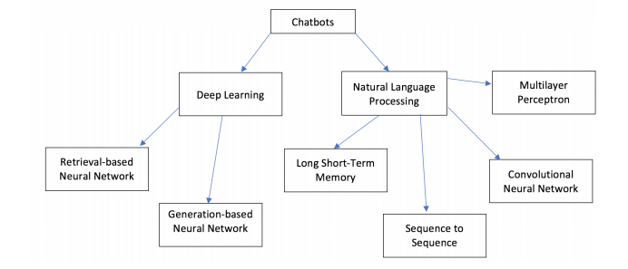
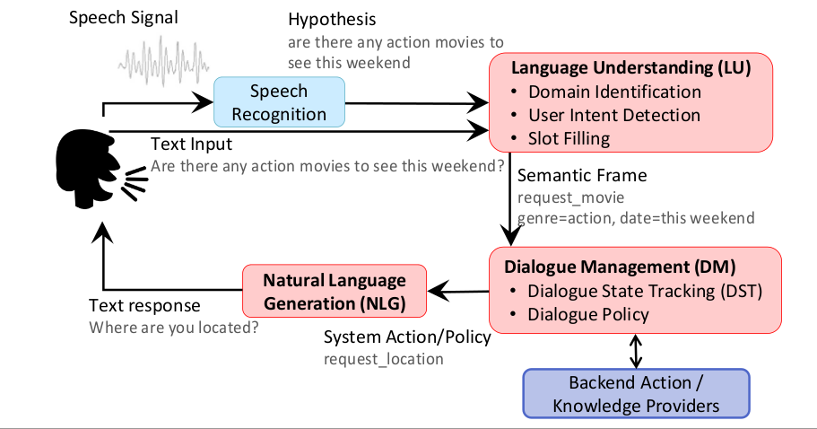
Text to Speech: The bot also speaks out the answer. Our system will also give output in both format text as well as in voice. Main benefit of audio output is, it is more understandable to user rather than read output

Slide 8
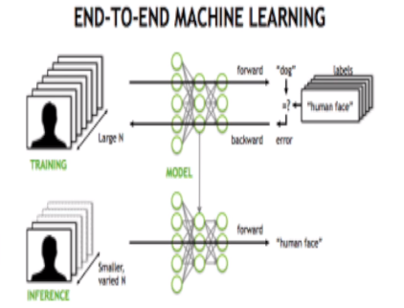
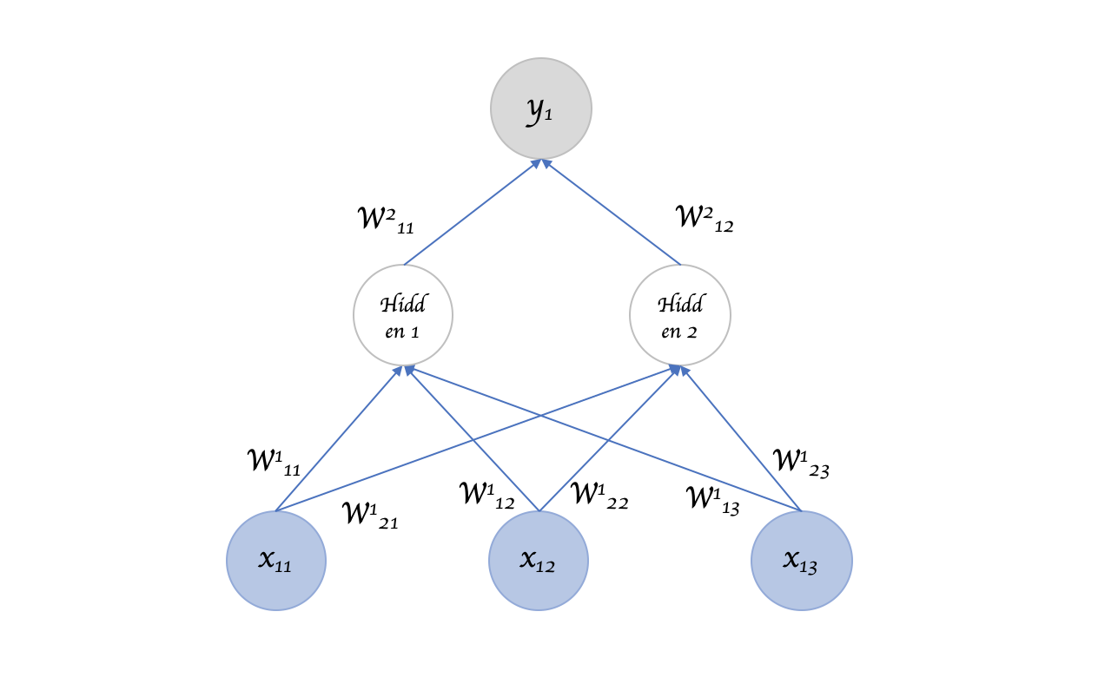
E.3 PROCESSING
Methods used in this application is to match the pattern (pattern-matching).
The bot would match the input sentence from the speaker or user with pattern that has existed on the knowledge.
Each pattern paired with the knowledge of bot which taken from various sources.
It uses different component to interrupt the language and to track the state of conversation and another one to generate a response
Each of these system would be trained separately and chatbot would collectively use the results from each
END-END MACHINE LEARNING Algorithm is used to Simplify the Above Processes
Recurrent neural networks are used in speech recognition, language translation, stock predictions; It's even used in image recognition to describe the content in pictures.
Recurrent Neural Network:

Slide 9
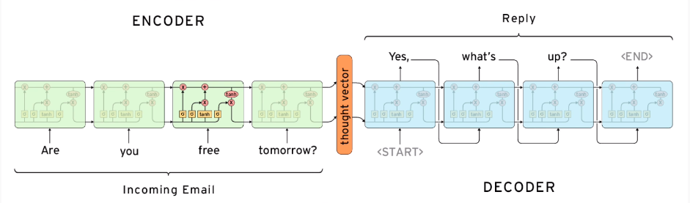
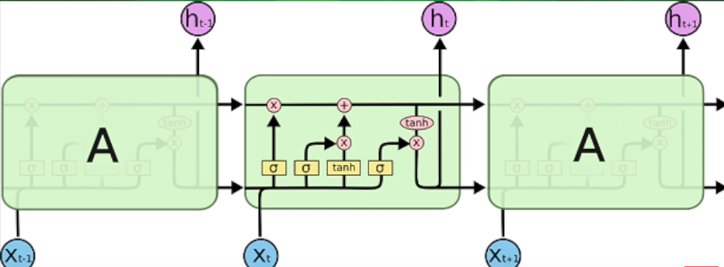
STEP 1: DOWNLOAD OUR DATASET:
We'll download our dataset and put it in our data directory.
Next we'll want to split our data into two different sets for training.
We'll call one set "encoder data“ and the other set "decoder data."
The encoder data will be the text from one side of the conversation.
The decoder data will be the responses.
Then we'll want to tokenize our data and give each token and integer ID.
"Tokenizing" means taking each sentence , Once our data is properly formatted.
STEP 2: CREATE OUR MODEL:
We can define our own function for this that takes our tokenized encoder and decoder data as its parameters.
Our function is going to return TensorFlow's built-in sequence-to-sequence model with what's called the embedding attention mechanism.
Let's break down what the F this means.

Slide 10
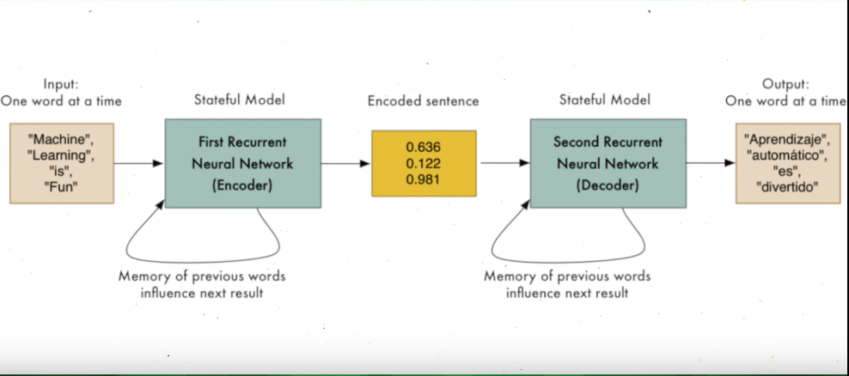
4. A sequence-to-sequence model consists of two recurrent neural networks. 5. One recurrent net is the encoder. 6. Its job is to create an internal representation of the sentence its given, which we can call a "context vector." 7. This is a statistical value that represents that sentence. The other recurrent net is the decoder. 8. Its job is to, given a context vector, output the associated words. The type of recurrent net we'll be using is called a "long short-term memory network." 9. This type of network can remember words from far back in the sequence and, because we're dealing with large sequences, our attention mechanism helps the decoder selectively look at the parts of the sequence that are most relevant for more accuracy. 10. So our model will be able to create context vectors for existing questions and responses and it'll know to associate a certain type of question with a certain type of response. So, once we create our model, we can train it

Slide 11
STEP 3: TRAIN OUR MODEL:
We can train it by first creating a TensorFlow session which will encapsulate our computation graph.
Then we'll initialize our training loop and call our session's run function which will run our computation graph which is our sequence-to-sequence model and we'll use it as our parameter
Now we can save our model periodically during training, using the TF train.saver function
This will save our model as a checkpoint file which we can later load once we're done training using the saver's restore function.
When we run our program, It'll take a few hours to fully train.
We can periodically test what kind of responses we get from our bot in terminal if we like, and, as you can see, responses are pretty meaningless at first, but, as our model improves through training, eventually it becomes more coherent.

Slide 12
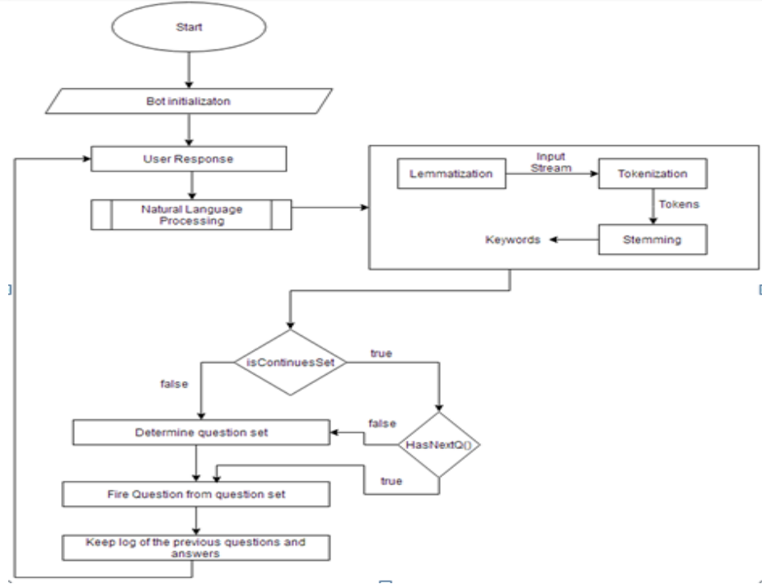
F. FLOWCHART

Slide 13
G. BREAK IT DOWN
Deep learning allows us to make chatbots that are way more humanlike than any kind of handcrafted chatbot we've made before.
End-to-end systems are systems that allow us to use a single model to give us our desired outcome.
We can use sequence-to-sequence models using two recurrent neural nets to create Career Counselling chatbots
H. RESULTS
Humanlike chatbot
Passed Turing Test
Can play Music and Sports Activity
Booking tickets can be done
Career Counselling For High school Students
Connectivity Among People’s
Personal Assistant
Mimic User Voice For Messaging and Phone Call
Rank Prediction And Guide For All Competitive Exams

